Slide 1
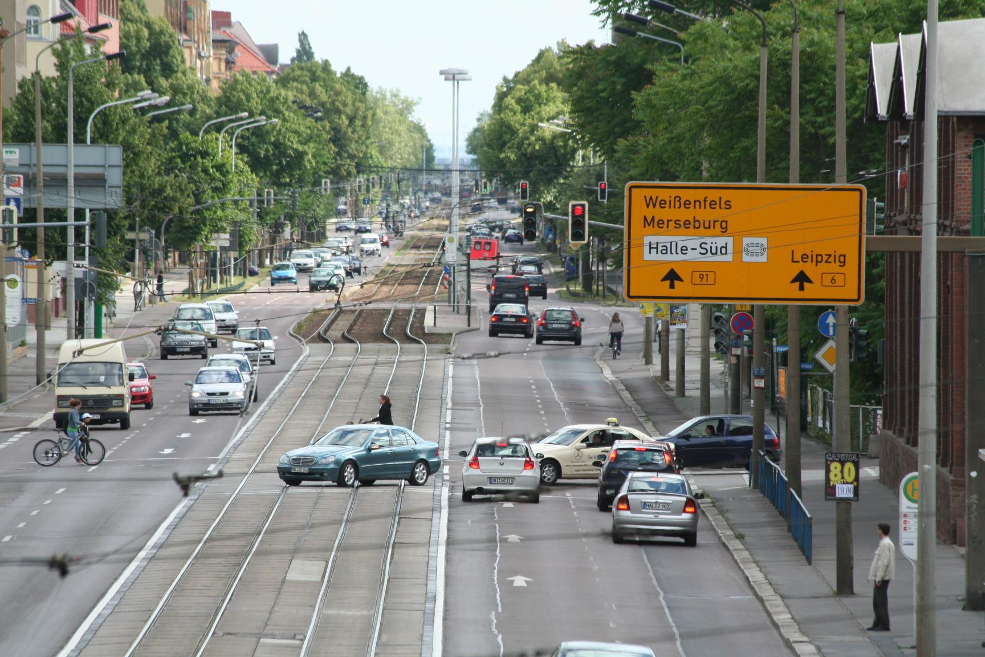
A novel Bayesian hierarchical
model for road safety hotspot prediction
Lee Fawcett , Neil Thorpe , Joseph Matthews , Karsten Kremer
Data
The available data consists of accident counts at 734 sites in Halle for the years 2004–2012 inclusive, which are the so-called observations.
For each site j = 1, ..., 734, we have covariates which include amongst others traffic volume, speed limit, or whether a respective site is located in an urban area

Slide 2
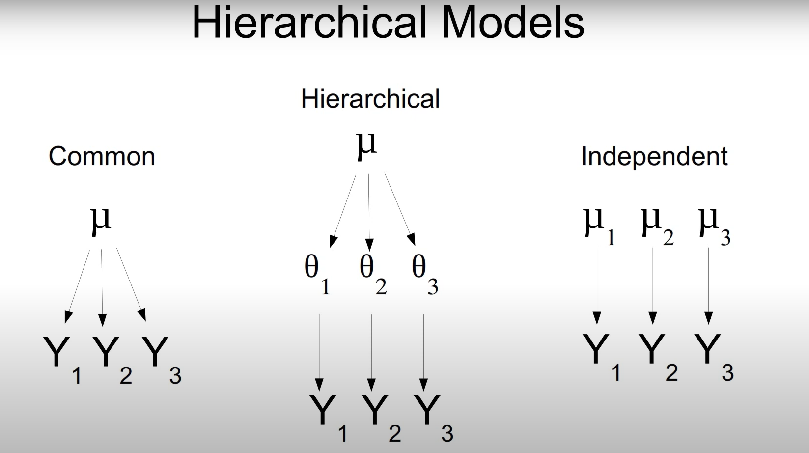
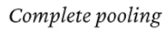
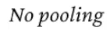

Slide 3
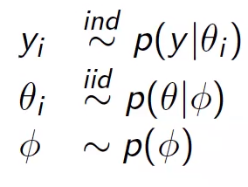
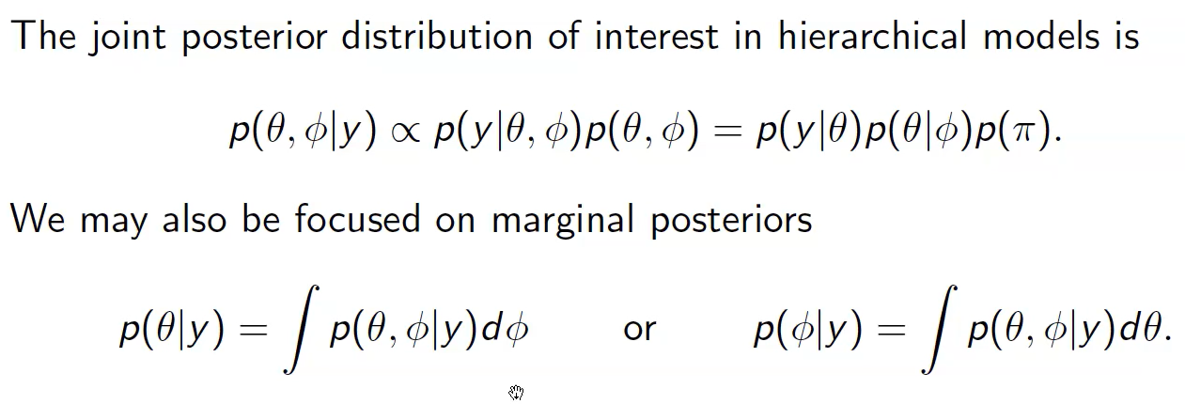

Simple Hierarchical Model
We have used the same approach in our model with more number of parameters but the underlying idea is same

Slide 4
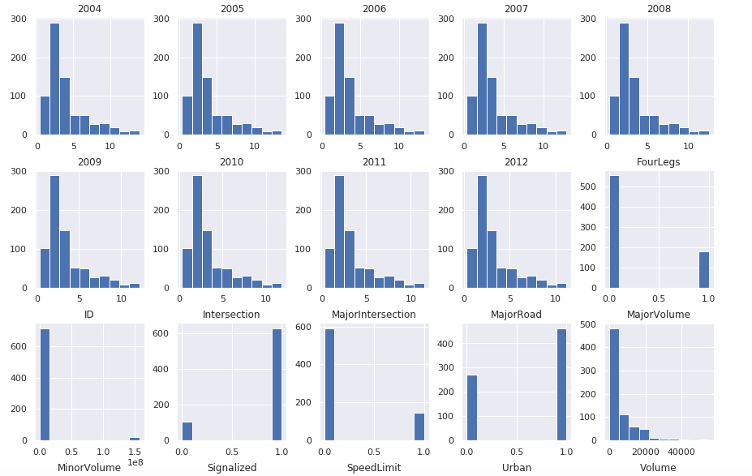
Our variables follow a distribution which we want to learn via our modeling
Distributions of all variables in the data
the distributions of yearly accident totals from 2004 to 2011.
count
all available covariates and their distributions
value
3

Slide 5
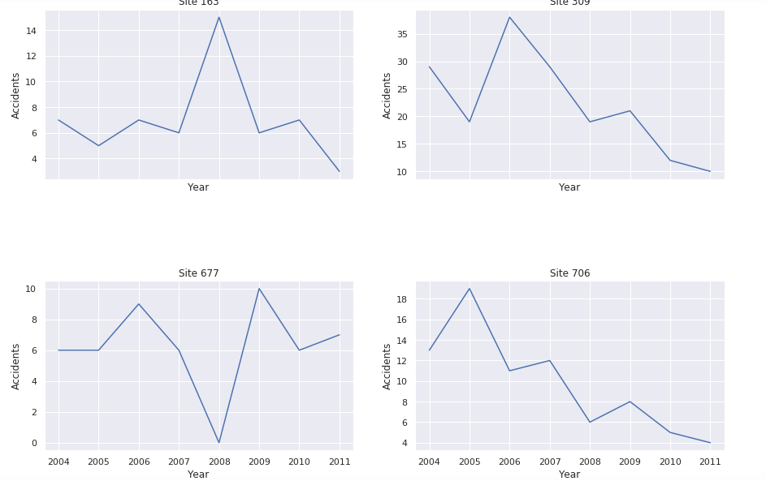
Accidents at sites have random effects and trend
– which we account for in our modelling
Time series plots of accidents at selected sites
Site 163 Site 309
Sites 163 and 677 indicate potential RTM effects
A recent peak in accidents at a site, e.g. in the previous year can either be due to a severe safety lack or due to a random increase. A random increase would lead to a decrease in accidents (regression to the mean) in the following year anyway––no matter whether measures were implemented or not. RTM effect may have occurred after 2008: the number of accidents naturally may have reverted back to an average level in 2009.
Sites 309 and 706 suggest evidence of temporal trend
the problem of trend i.e if a measure has been implemented, accidents might decrease due to either the measure itself––or due to site-specific or global trends, i.e. that people drive slower in general. trend can vary at a local level since downward-sloping is observed only for site 309 and 706
Accidents
Accidents
Year
Year
Site 677
Site 706
Accidents
Accidents
Year
Year
4

Slide 6
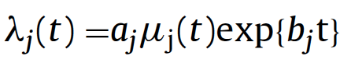
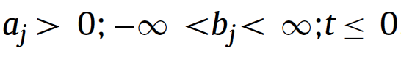



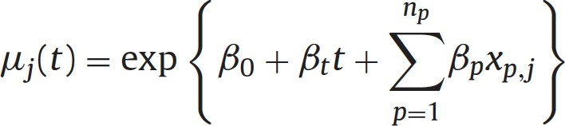

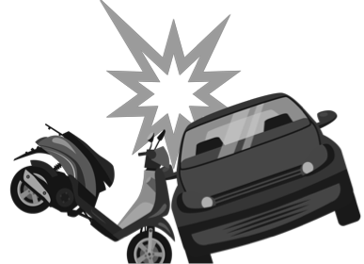
We follow the same steps as Fawcett et al. in their paper
Bayesian Hierarchical Model
Rank sites according to hotspot potential
Posterior Sampling
aj which accounts for random effects (RTM) and bj which tackles the confounding effects of local trend
Accident Prediction Model
Evaluation

Slide 7
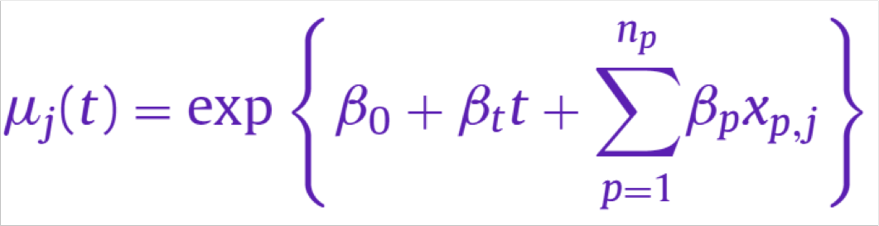
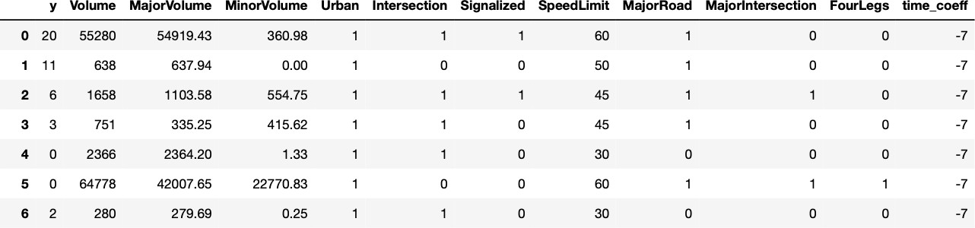
To implement the Accident Prediction Model, we have to do data rearrangement and calculate the coefficients first (1/2)
Modelling the APM according to Fawcett et al. 2017
7

Slide 8
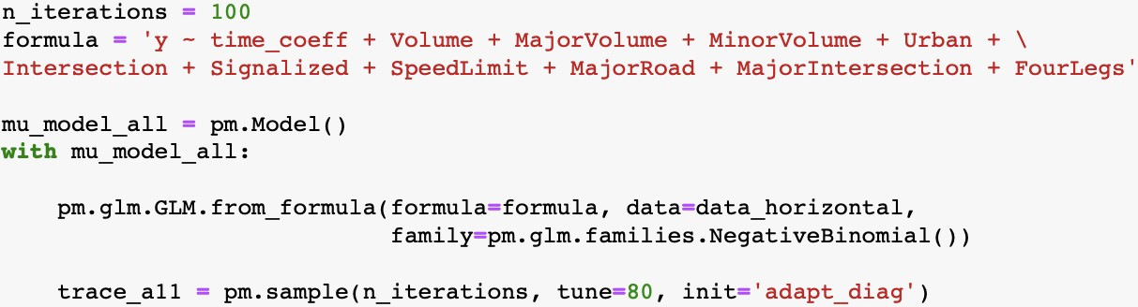
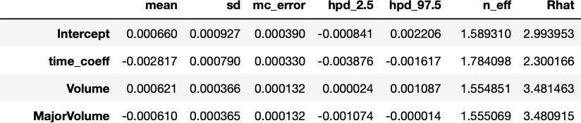
To implement the Accident Prediction Model, we have to do data rearrangement and calculate the coefficients first (2/2)
Modelling the APM according to Fawcett et al. 2017
7

Slide 9
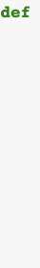
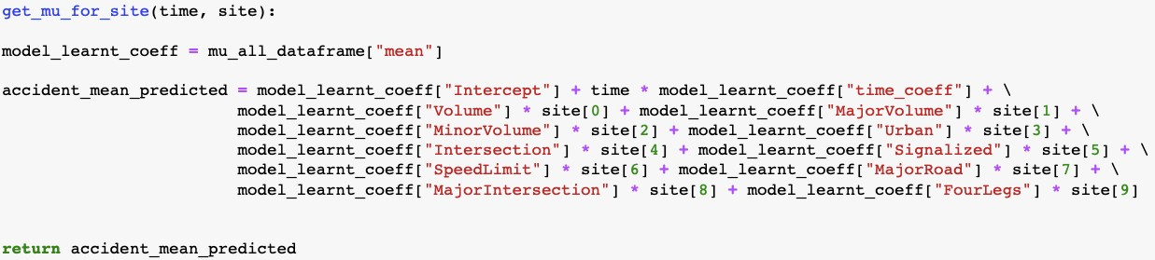
Then, we calculate the mean accident rate for each site and each time ...
Modelling the APM according to Fawcett et al. 2017
prefer recent years to stronger inform decisions––a lot could have happened in the meantime
8

Slide 10
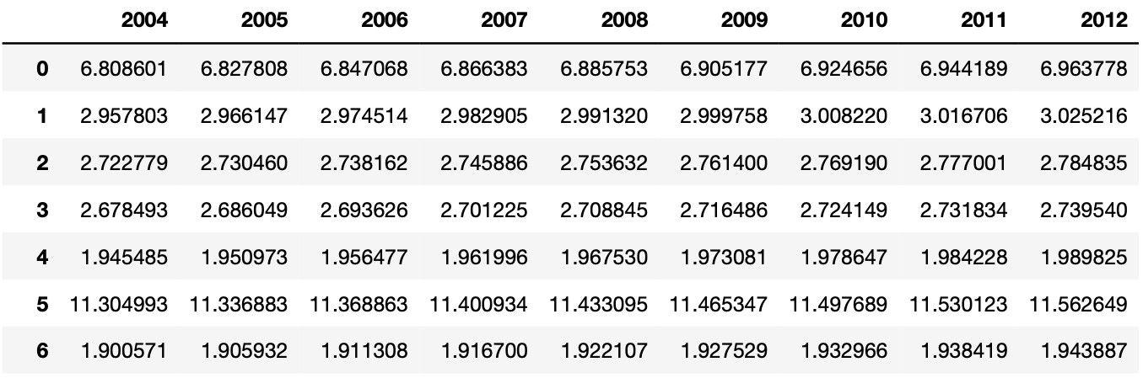
... and encounter two problems
Modelling the APM according to Fawcett et al. 2017
We do not account for RTM and trend yet!
8

Slide 11
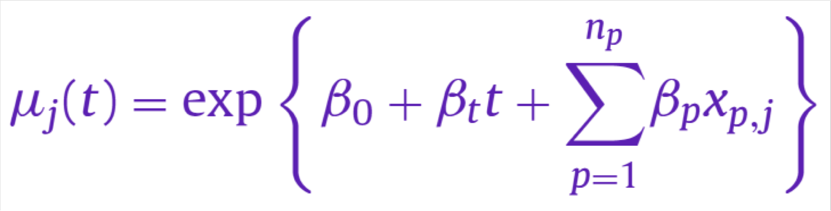
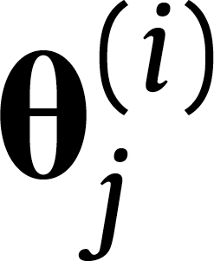
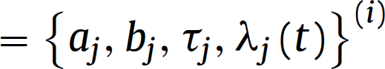
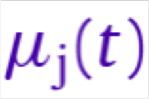
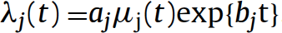
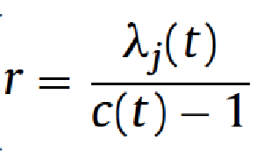
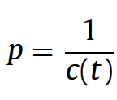
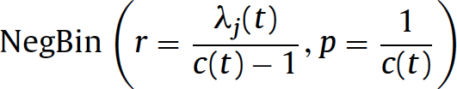
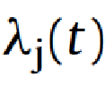
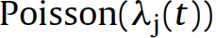
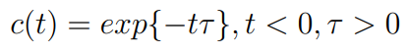
We account for RTM and trend by building a Bayesian Hierarchical Model on top of the APM
Model according for RTM and trend according to Fawcett et al. 2017
Negative Binomial distribution allows for different mean and variance, whereas for the Poisson distribution mean and variance are assumed to be the same . discrete data and the events occurring are independent of the time since the last event.
The reason behind including c(t) is to give more weight to recent accidents
9

Slide 12
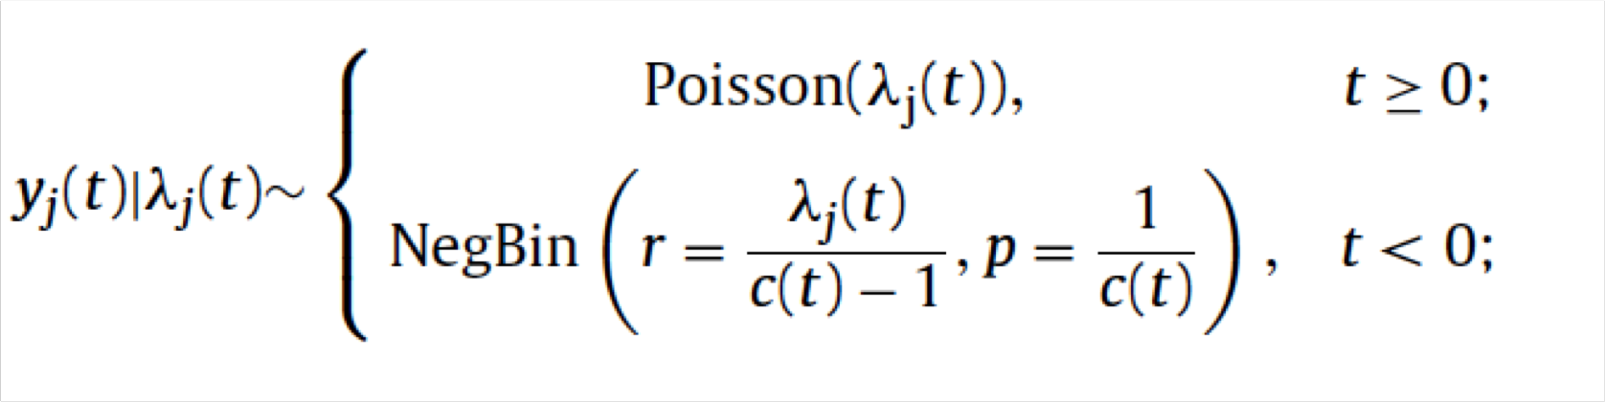
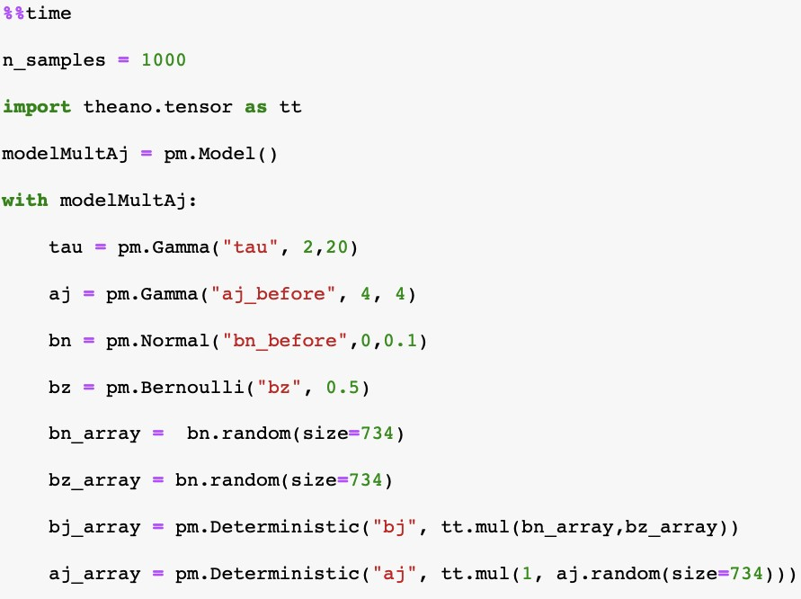
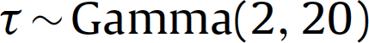
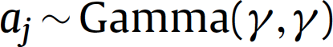
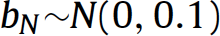
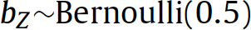
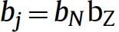
For the modeling, we first have to initialize the priors according to what is specified in the paper
Prior initialization
aj helps us to capture causes we have not captured in our observations
In bj , bz acts as the zero-inflation component that penalizes the global trend detected by the global APM.

Slide 13
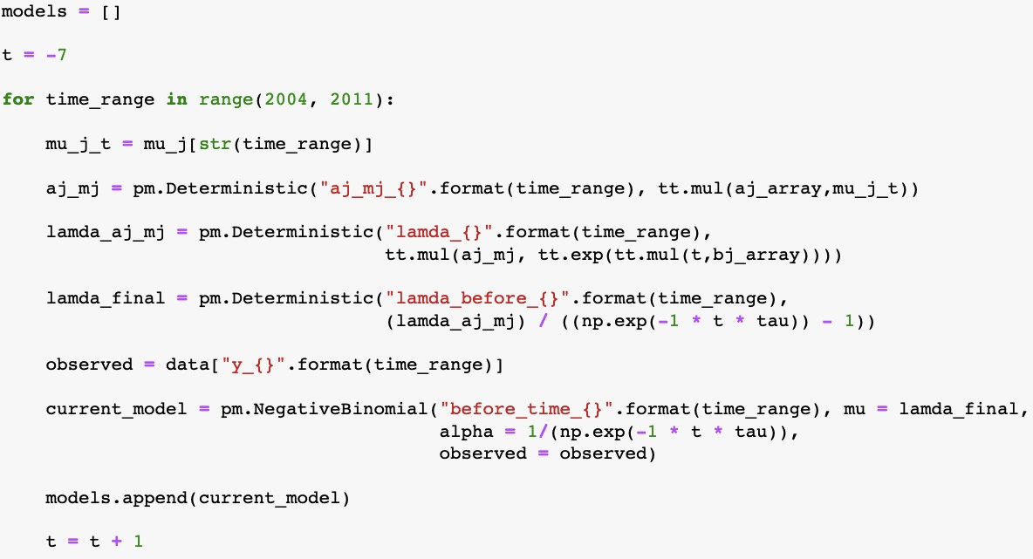
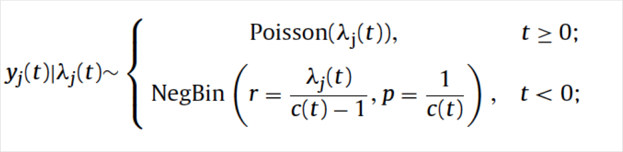
The pymc3 library allows us to smoothly apply a Negative Binomial Distribution to the “before” time period

Slide 14
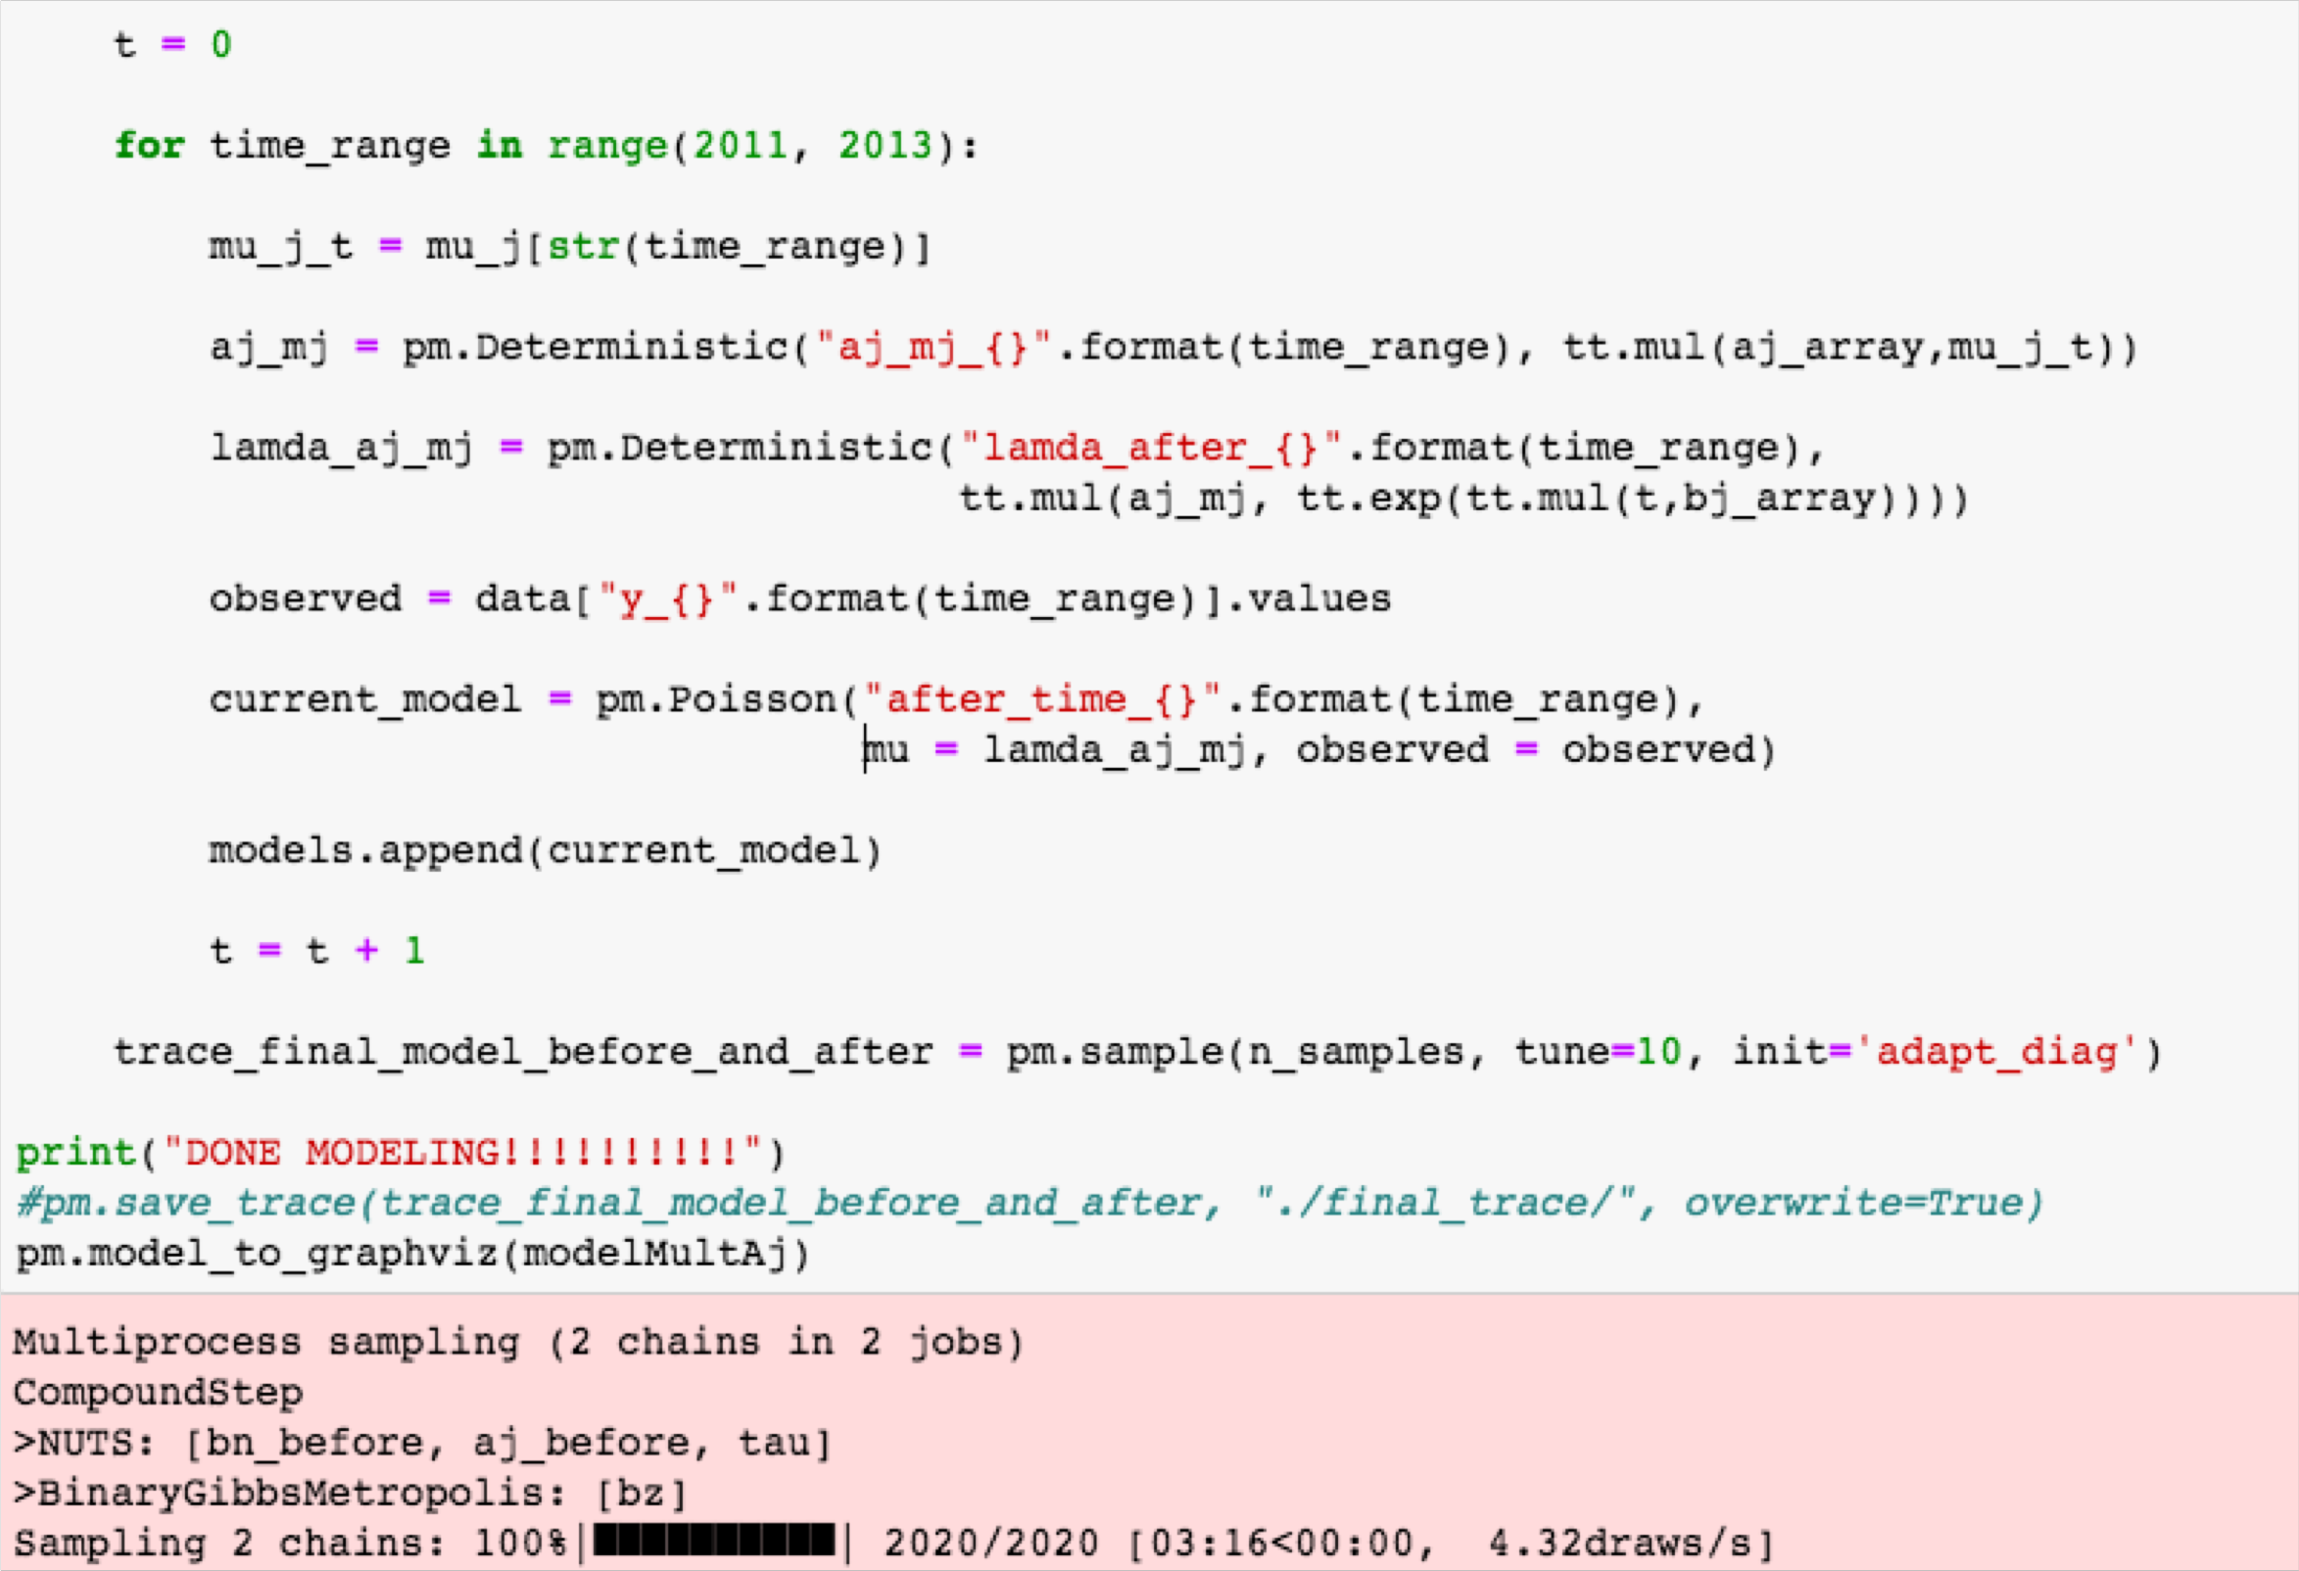

For the “after” time period data, we have applied a Poisson distribution

Slide 15
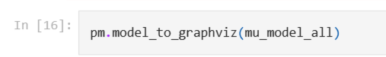
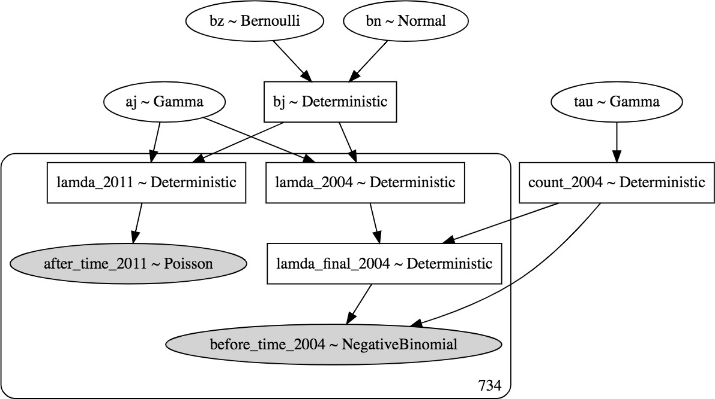
Plate notation of the model makes it easy to understand our model
Representation of our model based on Fawcett et al. 2017
MCMC sampling technique to simulate approximate draws from the marginal posterior
Trained the model with 1,000 iterations due to time and space constraints in paper it was 10,000
model was trained with Python using the pymc3 library

Slide 16
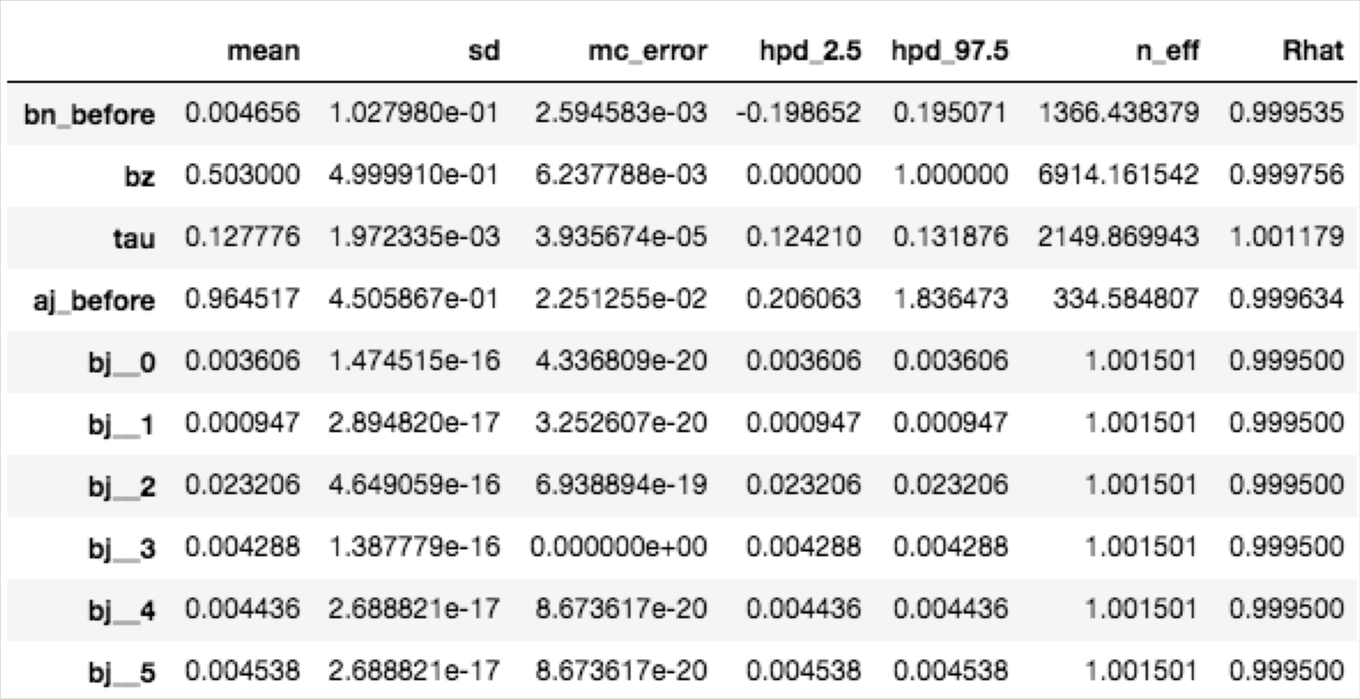
As the posterior summary indicates, we have learnt RTM and local trend for each site
Posterior summary of our model based on Fawcett et al. 2017

Slide 17
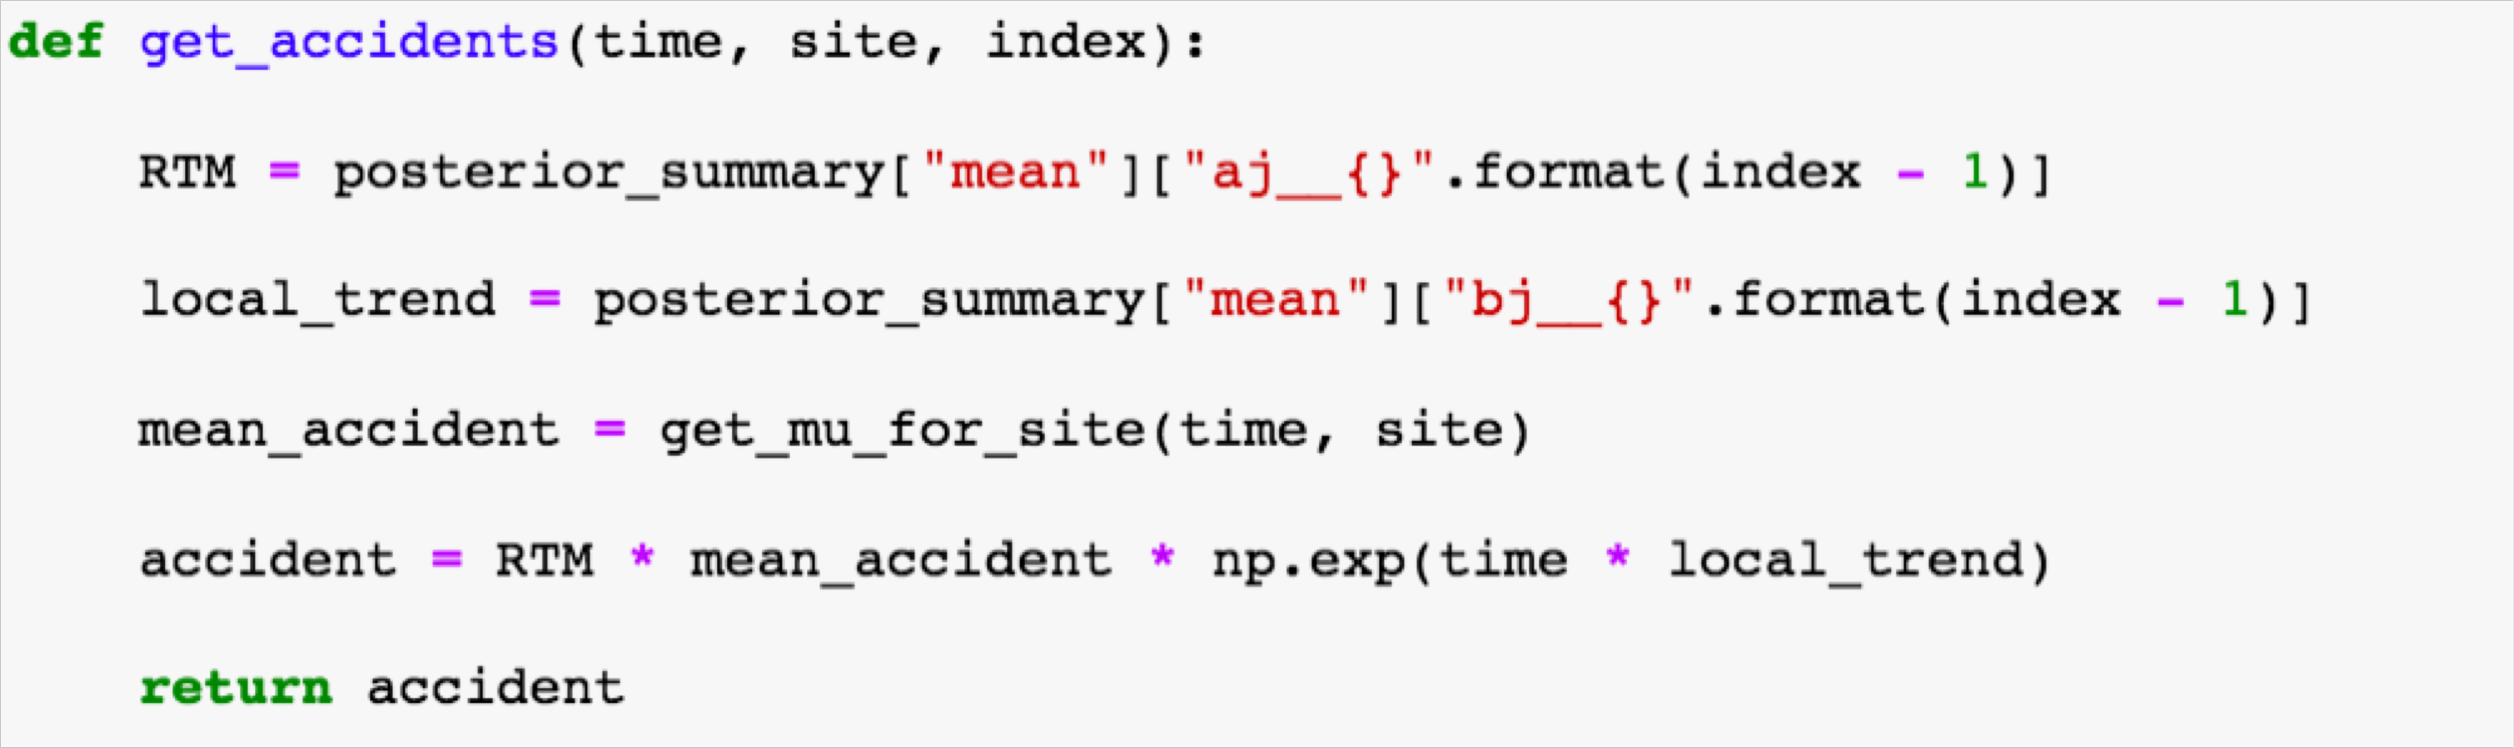
For accident predictions we need to use learnt RTM, local trend and global trend along with mean accidents
RTM
Local
Trend
Global
Trend

Slide 18
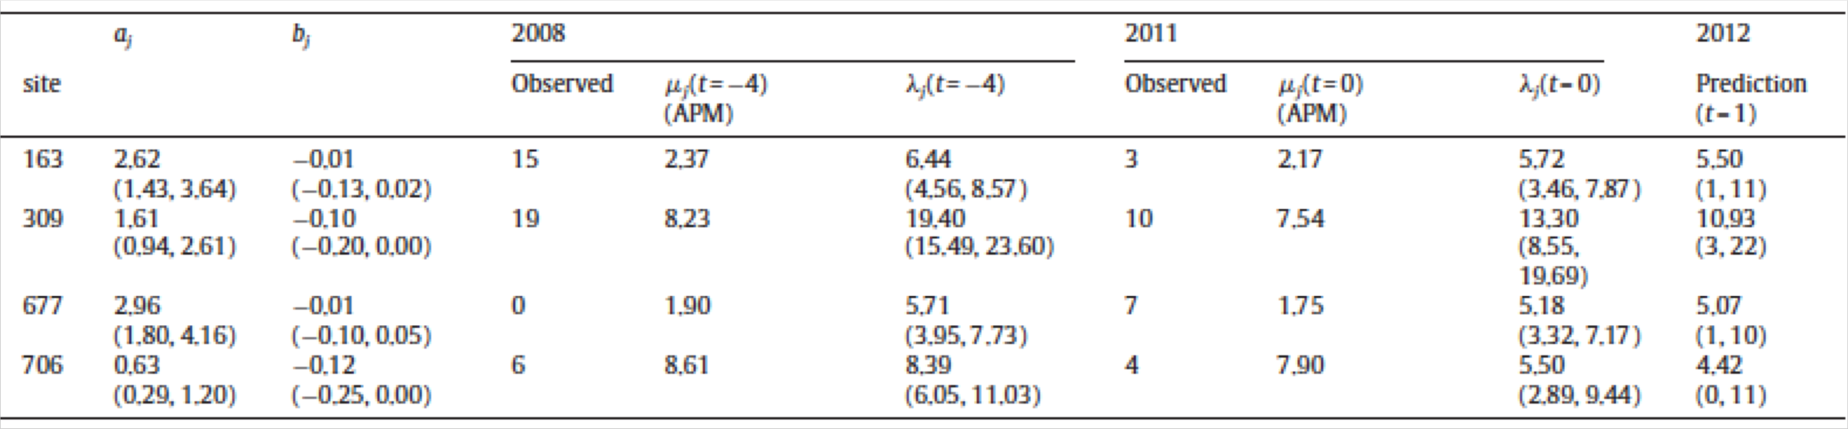
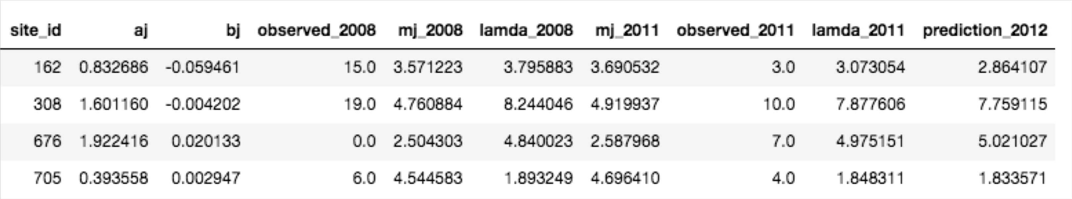
According to posterior results, the model we built is close to Fawcett et al. 2017
Comparison of posterior results

Slide 19
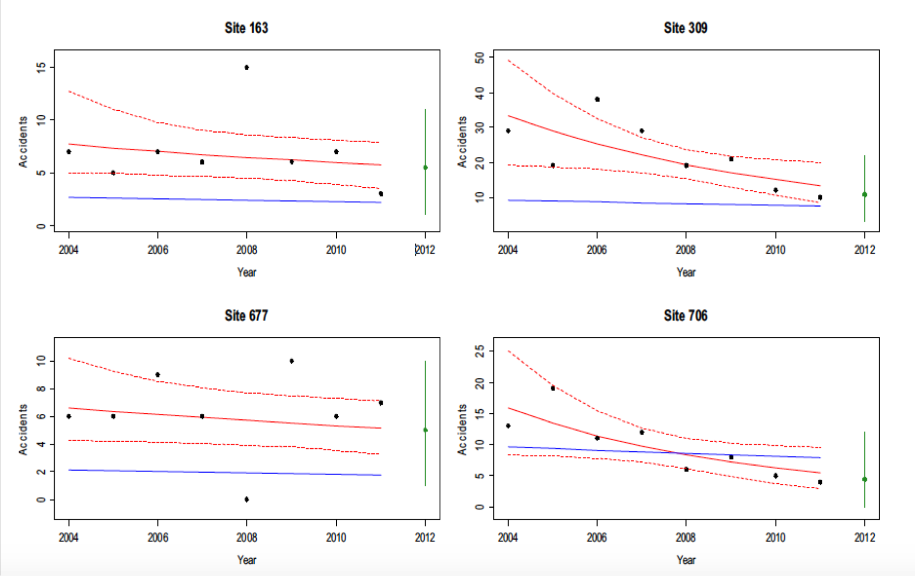
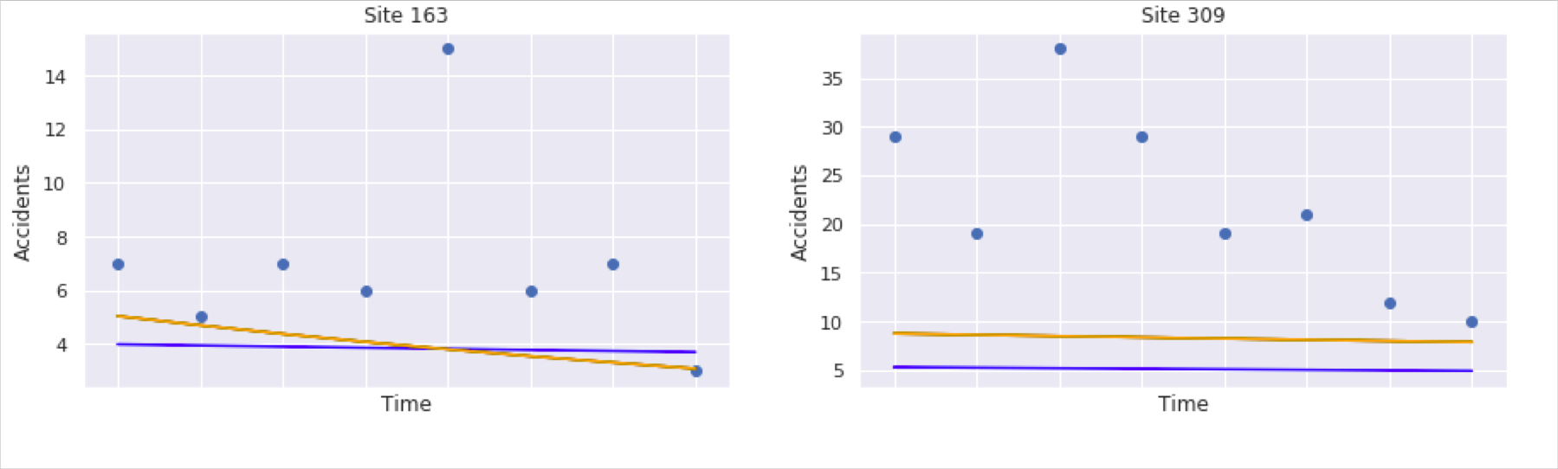
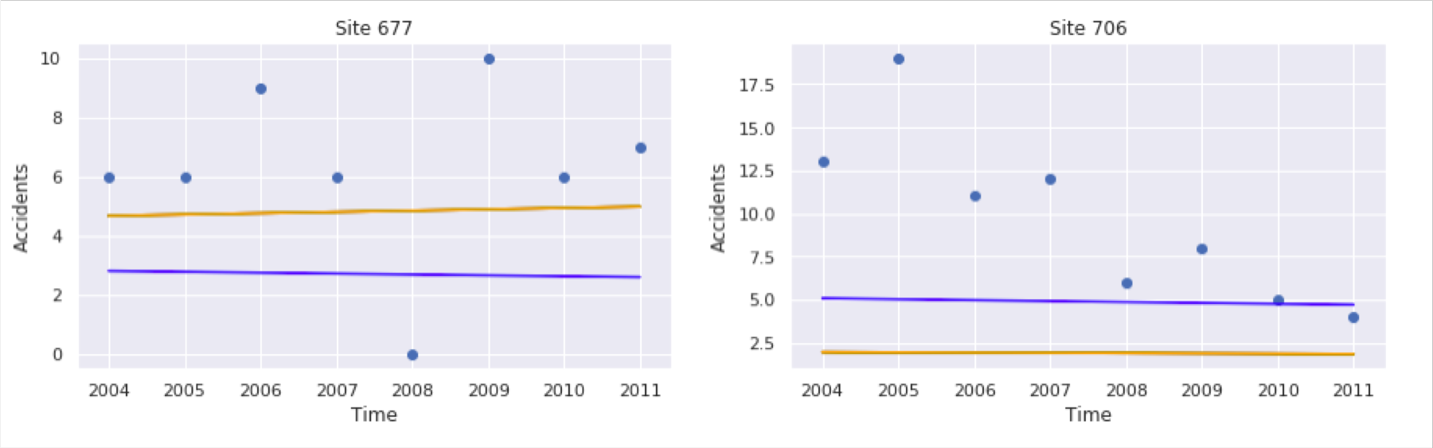
Our model has learned the trend element correctly and is fitting quite well
Comparison of (predicted) accidents at sites over years
Site 163
Site 309
Site 163
Site 309
Accidents
Accidents
Accidents
Accidents
Years
Years
Years
Years
Site 677
Site 706
Site 677
Site 706
Accidents
Accidents
Accidents
Accidents
Years
Years
Years
Years
the blue line indicates the model fitting of the mean accident rates and the red line indicates the model fitting of the Global APM

Slide 20
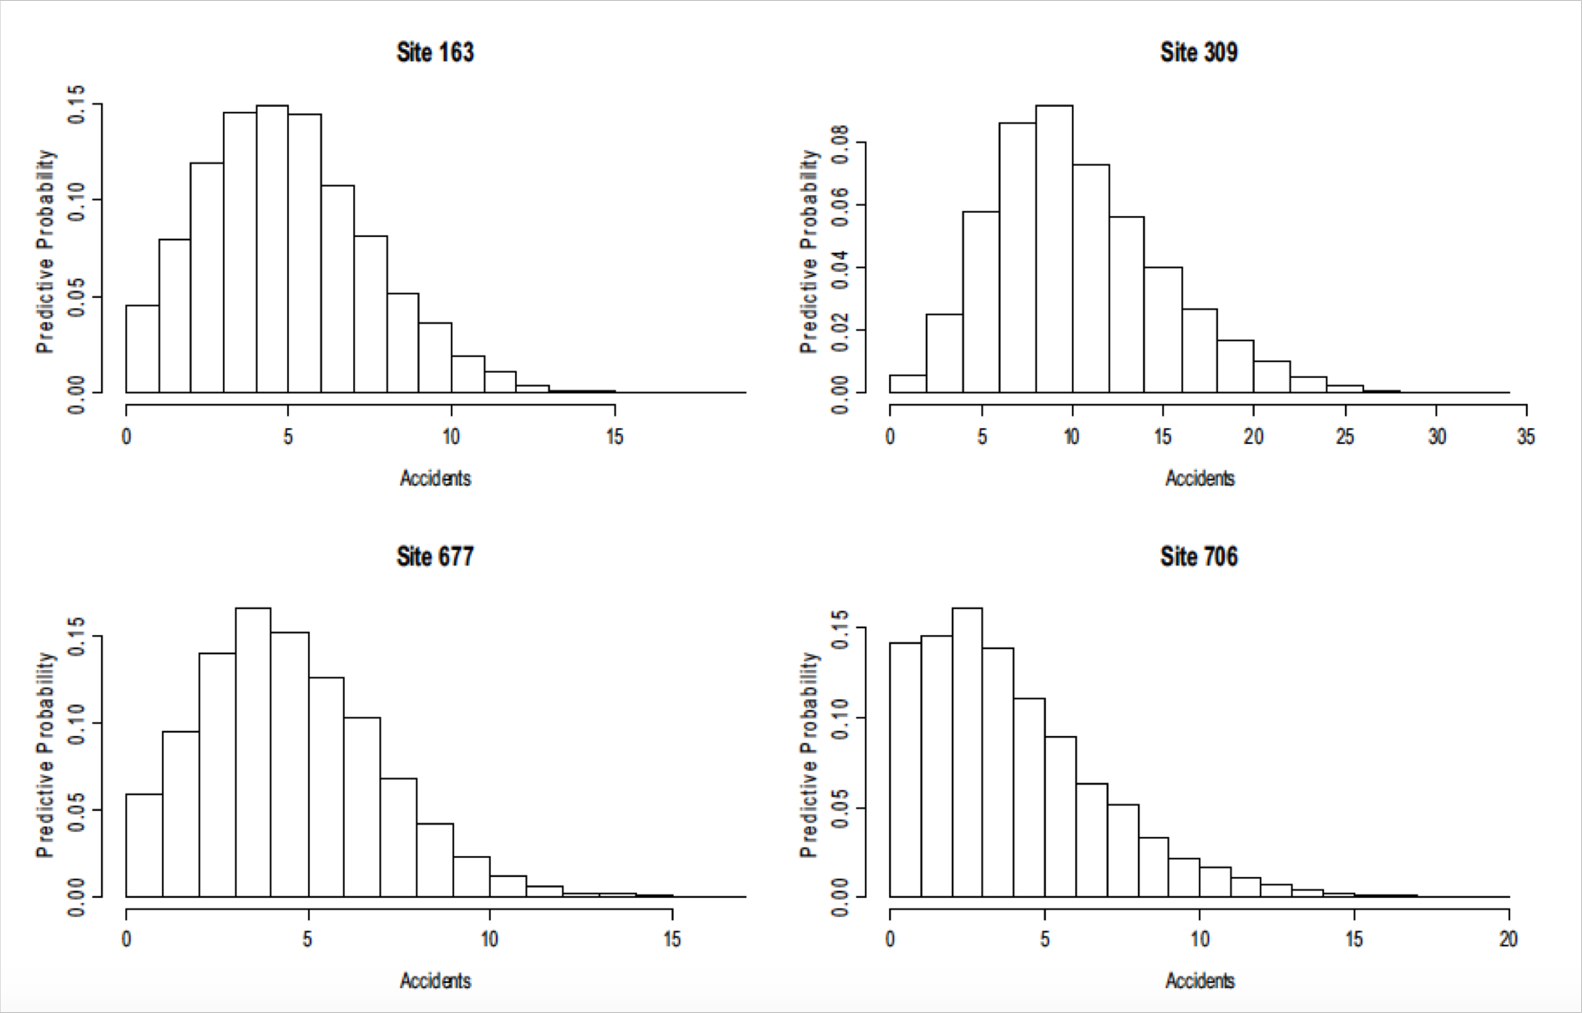

The model we built was able to generate similar posterior samples like in Fawcett et al. 2017
Comparison of posterior samples
Site 163
Site 309
Site 163
Site 309
Predictive Probability
Predictive Probability
Predictive Probability
Predictive Probability
Accidents
Accidents
Accidents
Accidents
Site 677
Site 706
Site 677
Site 706
Predictive Probability
Predictive Probability
Predictive Probability
Predictive Probability
Accidents
Accidents
Accidents
Accidents

Slide 21
Thank you!

